Slide 1
Explanatory and Predictive Modelling
-Sushma Babburi
-Naveen Kumar Ramba
-Krishma Punjabi
-Gaurav Jetley

Slide 2
Statistical Model and Computation
Embodies set of assumptions concerning the generation of observed data and similar data from a larger population.
non-deterministic
Three purposes:
  Predictions
  Extraction of information
  Description of stochastic structures(probability distribution)

Slide 3
Mathematical representation:
statistical model=Pair (S,P)
  S , sample space
  P , set of probability distributions on S
Statistical hypothesis tests and statistical estimators are derived from statistical models.
Statistical Modelling is a Powerful tool for developing and testing theories.
Statistical Computation aims at design of algorithm for implementing statistical methods on computers.

Slide 4
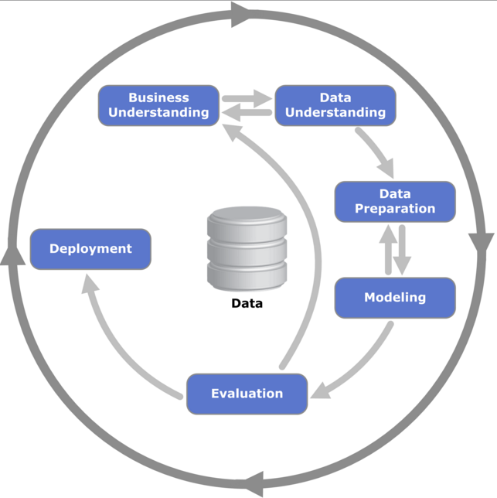
CRISP-DM
Cross Industry Standard Process for Data Mining

Slide 5
Tasks for data mining
There are four main tasks:
Prediction:
  Regression:- Predicting a real number.
  Classification:- Predicting a whole number or class.
          Instance of Supervised Learning.
Modelling: Same as prediction, but the model is comprehensible by humans.
Similarity:
  Factor analysis:- Trying to find natural groups of attributes.
  Clustering:- Trying to find natural groups of observations.
  Instance of Unsupervised Learning.
Association: Much like correlation, but for enormous binary datasets.

Slide 6
Explanatory Modelling
Refers to application of statistical models to data for testing casual hypothesis about theoretical constructs.
In such models, a set of underlying factors that are measured by variables X are assumed to cause an underlying effect, measured by variable Y

Slide 7
Predictive Modelling
Refers to application a statistical models or data mining algorithm to data for the purpose of predicting new or future observations.
Such models are used to predict the output value (Y ) for new observations given their input values (X)

Slide 8
Explanatory Vs Predictive Modelling
OPERATION | EXPLANATORY TASK | PREDICTIVE TASK
Types of Models | Linear, logistic, probit, etc. | Same + shrinkage models (ridge regression, PCR, ensemble methods)
Choice of independent variables (X) | Based on theory/hypotheses; causal relationship assumed (with Y) | based on association; availability at time of prediction; measurement accuracy important
Data preprocessing | Visualization, summaries, outlier detection, imputation | Same, except missing data are treated differently
Data partitioning (training/holdout) | Not typical, except for robustness testing | Always required

Slide 9
Explanatory Vs Predictive Modelling
OPERATION | EXPLANATORY TASK | PREDICTIVE TASK
Software | Any statistical software (as simple as Excel) | Ordinary software requires tweaking (data partitioning, performance metrics); or data mining software (Clementine, SAS EM, XLMiner)
Estimation method | Maximum likelihood | Same
Model selection goal | Determine important factors | Dimension reduction, parsimony
Model selection Methods | Stepwise, forward, etc. | Same
Multicollinearity | A serious danger, risk of incorrect inference | Not too important

Slide 10
Explanatory Vs Predictive Modelling
OPERATION | EXPLANATORY TASK | PREDICTIVE TASK
Evaluation criteria | Theoretical justification, goodness of fit, statistical significance | Parsimony, predictive accuracy, costs, practical deployment
Performance metrics | R2, MSE, residual analysis, coefficient and overall p-values | Predictive accuracy (RMSE, MAPE, lift) computed from holdout dataset
Dangers | Model misspecification, type I and II errors | Over-fitting
Model use (research) | Test hypotheses/theory | Discover new relationships, evaluate magnitude of effects, assess predictability
Model use (practice) | Determine important factors | Score new data

Slide 11
Applications of Explanatory models
Used in many scientific fields such as
  Economics(analyzing models of financial variability),
  Psychology(model for psychiatric disorders),
  Education(chemistry, computers, etc.), and
  environmental science(planetary biological models)
IS literature:
  finding determinants of auction prices,
  explaining the diffusion and non-diffusion of e-commerce among SMEs,
  explaining attitudes towards online security and privacy

Slide 12
Applications of Predictive models
In fields such as natural language processing and bioinformatics
To predict the price of ongoing eBay auctions
To predict future box-office sales based on online movie ratings
To detect crimes and identify suspects, after the crime has taken place

Slide 13
Predictive Models

Slide 14
Bootstrapping
Practice of estimation of any statistic using random sampling methods.
The bootstrap sample is taken from the original using sampling with replacement.
This method tests a model’s performance on certain subsets of data over and over again to provide an estimate of accuracy.

Slide 15
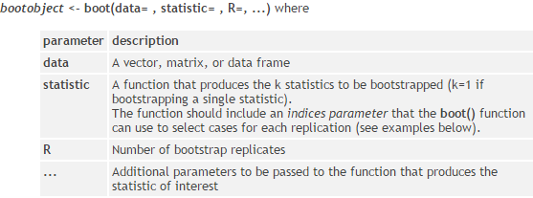
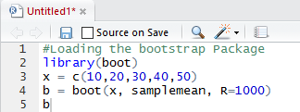
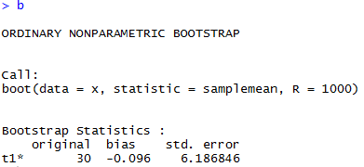
Bootstrapping in R

Slide 16
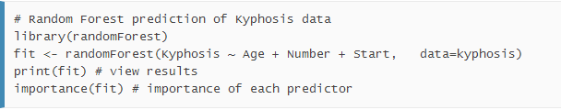
Random Forests
Random forests are an ensemble learning method for classification, regression and other tasks.
They operate by constructing a multitude of decision trees and outputting the class that is the mode of the classes (classification) or mean prediction (regression) of the individual trees.
It is a way of averaging multiple deep decision trees, trained on different parts of the same training set, with the goal of reducing the variance.

Slide 17
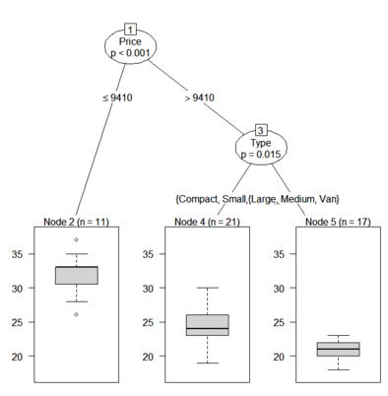

Conditional Inference Trees
Conditional inference trees estimate a regression relationship by binary recursive partitioning in a conditional inference framework.

Slide 18
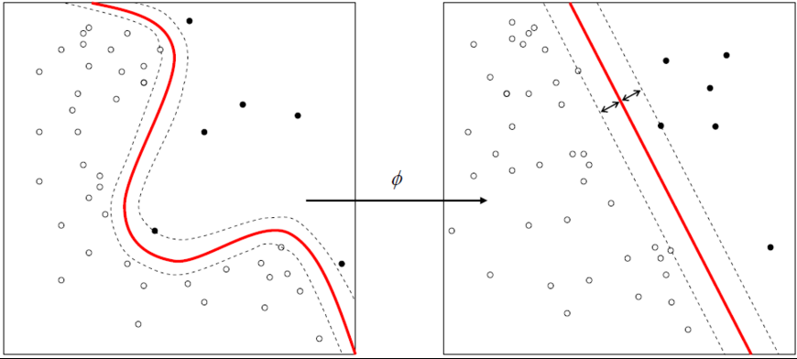
Support Vector Machines
Support vector machines (SVMs) are supervised learning models with associated learning algorithms that analyze data and recognize patterns, used for classification and regression analysis.
An SVM model is a representation of the examples as points in space, mapped so that the examples of the separate categories are divided by a clear gap that is as wide as possible.

Slide 19
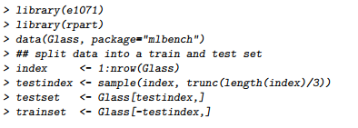

SVM in R

Slide 20
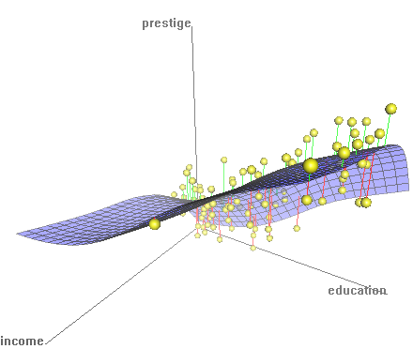
Nonparametric Regression
Nonparametric regression is a form of regression analysis in which the predictor does not take a predetermined form but is constructed according to information derived from the data.
R> npreg((bws, data = NULL, newdata = NULL, ...))

Slide 21
Explanatory Models

Slide 22
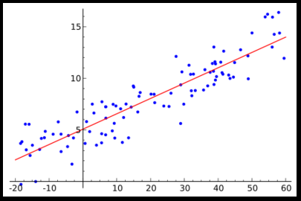

Linear Regression
Linear regression is an approach for modeling the relationship between a scalar dependent variable y and one or more explanatory variables (or independent variables) denoted X
Data are modeled using linear predictor functions, and unknown model parameters are estimated from the data

Slide 23
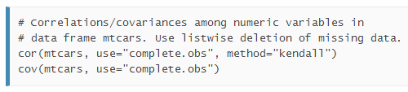
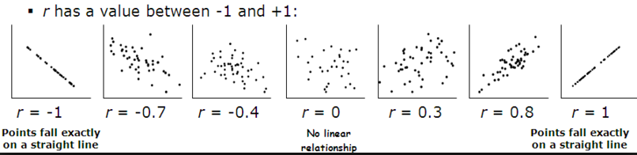
Correlation Analysis
The correlation coefficient is a measure of linear association between two variables
Values of the correlation coefficient are always between -1 and +1

Slide 24


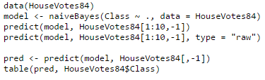
Naive Bayes Classifier
Naive Bayes classifiers are a family of probabilistic classifiers based on applying Bayes' theorem
The standard naive Bayes classifier assumes independence of the predictor variables, and Gaussian distribution of metric predictors.
For attributes with missing values, the corresponding table entries are omitted for prediction.

Slide 25
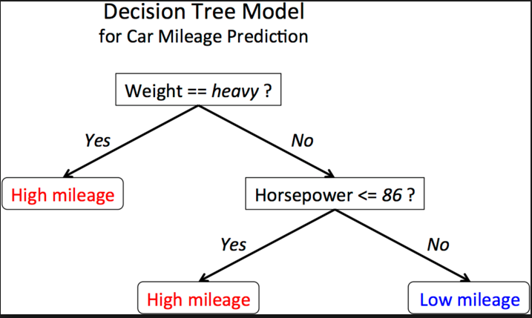
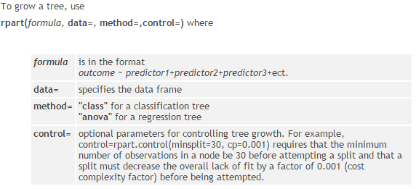
Decision Tree
Decision tree is a decision support tool that uses a tree-like graph or model of decisions and their possible consequences, including chance event outcomes, resource costs, and utility.
These are commonly used in operations research, specifically in decision analysis, to help identify a strategy most likely to reach a goal.

Slide 26
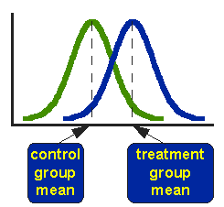
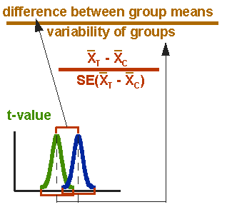
T-Test
A t-test is any statistical hypothesis test in which the test statistic follows a Student's t-distribution if the null hypothesis is supported.
Appropriate when comparing the means of two groups
Helps in assessing whether the means of two groups are statistically different from each other.

Slide 27
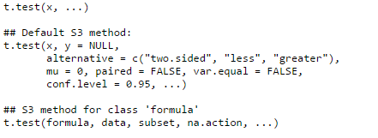
T-Test in R

Slide 28
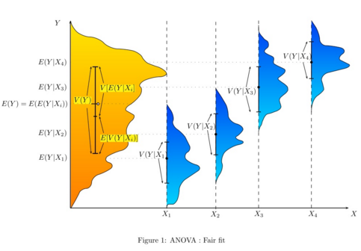
ANOVA
ANOVA provides a statistical test of whether or not the means of several groups are equal, and therefore generalizes the t-test to more than two groups
Doing multiple two-sample t-tests would result in an increased chance of committing a statistical type I error
ANOVAs are useful for comparing (testing) three or more means (groups or variables) for statistical significance.

Slide 29
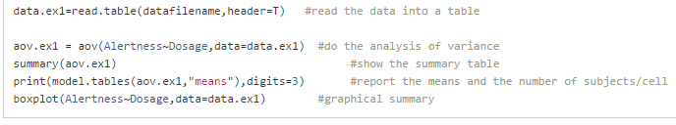
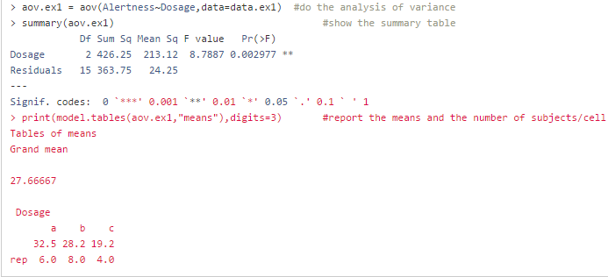
ANOVA in R

Slide 30
Types of Model Validation

Slide 31
P-Value
Explanatory
When performing hypothesis testing, the p-value is used to determine the strength of your results/evidence derived from data.
0.05 < p-value =< 0.05
Weak
Strong

Slide 32
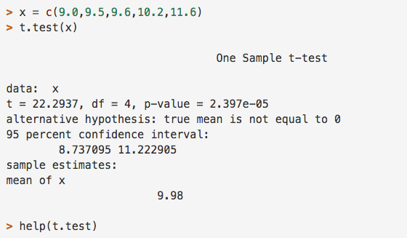
P-Value R Code
Easiest way to generate the p-value of
your data set: Run a t-test!!!

Slide 33
R² & Adjusted R²
Explanatory & Predictive
R² is the coefficient of determination. It is a measure of how well the regression line approximates the real data point – how well the line fits.
Adjusted R² is used to compare multiple linear regression models.

Slide 34
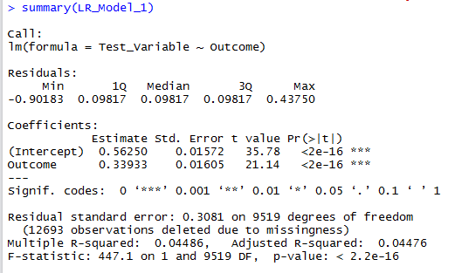
R² & Adjusted R² R-Code

Slide 35
AIC & BIC
Explanatory
AIC - AKAIKE INFORMATION CRITERION
BIC - Bayesian Information Criterion
AIC and BIC are model selection tools. The AIC score gives an estimate of the model performance on the testing set.
The lower AIC and BIC scores the better the model!
Theses tools helps to filter out unnecessarily complicated models with excessive parameters.
AIC is preferred for complex models & BIC is preferred for simpler models.

Slide 36
AIC & BIC R-Code
Usage
AIC(object, ..., k = 2) BIC(object, ...)
Arguments
Object
a fitted model object for which there exists a logLik method to extract the corresponding log- likelihood, or an object inheriting from class logLik.
...
optionally more fitted model objects.
k
numeric, the penalty per parameter to be used; the default k = 2 is the classical AIC.

Slide 37
K-Fold Cross Validation
Predictive
In k-fold cross-validation, the original sample is randomly partitioned into k equal sized subsamples.
Using the k subsamples, a single one is retained and the remaining k − 1 subsamples are used as training data.
The cross-validation process is then repeated ktimes (the folds). (Each k subsample is used only once!)
The k results from the folds are then averaged (or combined) to produce a single estimation.

Slide 38

K-fold Cross Validation R-Code
Library needed: DAAG

Slide 39



Cross Validation Metrics
Predictive
Mean Squared Error (MSE) – measure of how close a fitted line is to its data points.
Root Mean Squared Error (RMSE) – square root of the MSE; amplifies and punishes large error.
  Gives the std. deviation of model
    prediction error.
Mean Absolute Percentage Error (MAPE) – a measure of prediction accuracy of a forecasting method (expressed in percentages)

Slide 40
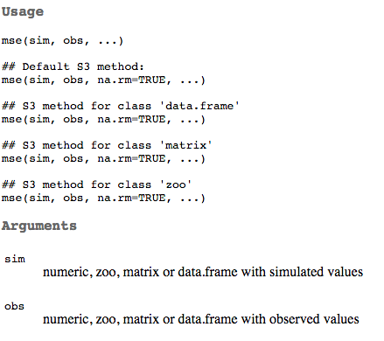
Cross Validation Metrics R-code
Mean
Squared
Error
(MSE)
Package:
hydroGOF

Slide 41
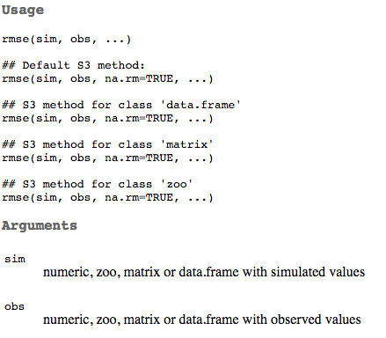
Cross Validation Metrics R-code
Root
Mean
Squared
Error
(RMSE)
Package:
hydroGOF

Slide 42


Cross Validation Metrics R-code
Root Mean Squared Error (RMSE)
Mean Absolute Percentage Error (MAPE)

Slide 43
Step-wise Selection
Predictive
Stepwise selection allows for the dropping or adding variables in either direction – forward, backward or both.
Backward stepwise selection – start off in a backward approach and then you add back variables that appear to be significant later on.
In layman terms, the process drops variables and then re-considers significant variables and then allow for re-introduction of them.
Forward stepwise selection – variables will be dropped if they are not significant when compared to other variables added later on in the process.
Notes:
\

Slide 44
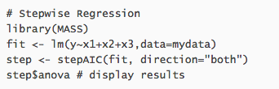
Step-wise Selection R-code

Slide 45
Bagging aka Bootstrap Aggregation
Predictive
Bagging is a method used to reduce over-fitting and reduce variance.
How do you determine if there is a variance? After you split the data and train them, if your predications are difference your data has a variance.
It is used as a way to improve the generalization by averaging lots of bootstrapped models. By averaging the models, you lower variance without affecting the bias. This in turn improves accuracy.
Usually used with decision trees methods.

Slide 46
Bagging R-code
Needed: libraries for parallel processing
library(foreach)
library(doMC)
registerDoMC(2) #change the 2 to your number of CPU cores
#function for bagged glm
bagReg <- function(string_model, string_train_data_in_model_name,
train_data, test_data, m_trials) {
tmp_model = sub(pattern=string_train_data_in_model_name,
replacement="train_data[sample(nrow(train_data),replace=TRUE),]",
x=string_model)
vector_trials = 1:m_trials
list_output = foreach(j=vector_trials, .combine = '+', .inorder = FALSE, .final = function(x) x/m_trials) %dopar% {
eval(parse(text=paste("predict(",tmp_model,",test_data)",sep='')))
}
return(unlist(list_output))
}
#example to compare bagged and normal glm
#notice train_dataXYZ in model and the string_train_data_in_model_name have to be exactly the same
example_prediction = bagReg(string_model = "glm(formula = mpg ~ cyl + hp + wt + qsec + disp, data = train_dataXYZ)",
string_train_data_in_model_name = "train_dataXYZ",
train_data = mtcars[1:20,], test_data = mtcars[21:32,], m_trials= 300
)
normal_prediction = predict(glm(formula = mpg ~ cyl + hp + wt + qsec + disp, data = mtcars[1:20,]), mtcars[21:32,])

Slide 47
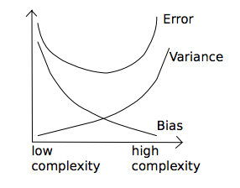
Bias vs Variance Tradeoff
Error due to BIAS | Error due to VARIANCE
The difference between the expected (or average) prediction of our model and the correct value which we are trying to predict | The variability of a model prediction for a given data point
Notes:
The bias of an estimator is its average error for different training sets.
The variance of an estimator indicates how sensitive it is to varying training sets.

Slide 48
Application of Model Validations in the Real World
What metric is used in Academia?
  AIC, BIC
What metric is used in Bio Stats?
  Bootstrap Aggregation
What metric is used in Production/industry?
  Cross validation or Step-wise selection

Slide 49
Appendix
http://scott.fortmann-roe.com/docs/BiasVariance.html
https://www.rforge.net/doc/packages/hydroGOF/mse.html
http://www.stat.ubc.ca/~rollin/teach/643w04/lec/node43.html
http://scikit-learn.org/stable/modules/learning_curve.html
http://users.cecs.anu.edu.au/~jdomke/courses/sml2011/02overfitting.pdf
http://scikit-learn.org/stable/modules/cross_validation.html
http://www.link.ch/wp-content/uploads/2013/10/CrossValidationFinal.pdf

